Slide 1
Data for Good
Child Poverty Action Lab

Slide 2
Outline
Workflow
% of accessibility of Jobs with Living Wage
By Car
30 Mins
60 Mins
By Transit
30 Mins
60 Mins
Population
Grocery Store
Women’s Clinic
Basic Medical Clinic
WIC Center

Slide 3
Workflow
Accessibility to Jobs:
LODES data aggregation and filtering to City of Dallas Census Block Groups
Open Trip Planner to compute duration of travel by Car and by Walk, Transit
Aggregation to compute % accessibility from each Census Block Group and mapping

Slide 4
Workflow
Accessibility to Other Resources:
Location information for WIC centers, grocery stores, healthcare from themap.io and google maps
Open Trip Planner to compute duration of travel by Car and by Walk, Transit
Mapping accessibility from each Census Block Group to various resources

Slide 5
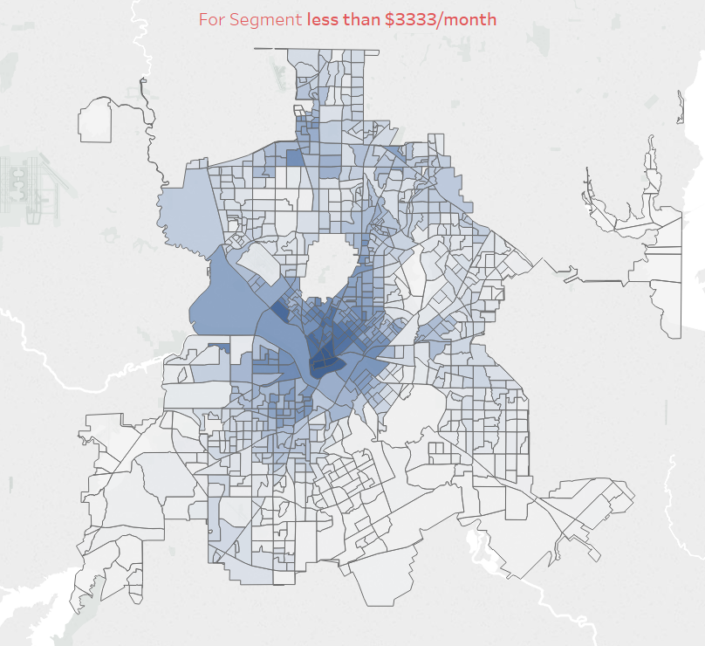
% Accessibility of Jobs within 30 Mins by Transit
Dark Blue
30 – 40 %
Blue
20- 30 %
10 – 20 %
Light Blue
0 – 10 %
White

Slide 6
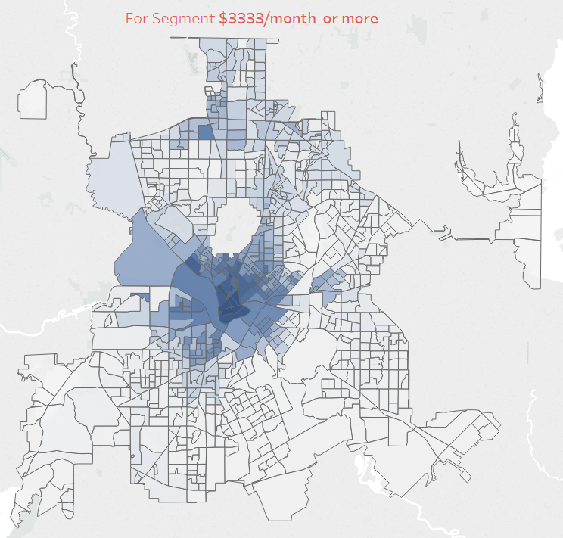
% Accessibility of Jobs within 30 Mins by Transit
Dark Blue
30 – 40 %
Blue
20- 30 %
10 – 20 %
Light Blue
0 – 10 %
White

Slide 7
Accessibility of Jobs within 30 Mins Insights
The maximum percentage of jobs that can be accessed with 30mins by transit is 27% for segment wages below $3333/month.
The maximum percentage of jobs that can be accessed with 30mins by transit is 37% for segment wages $3333/month and above.
Most of the area have job accessibility between 25% to 35% for both the segments.

Slide 8
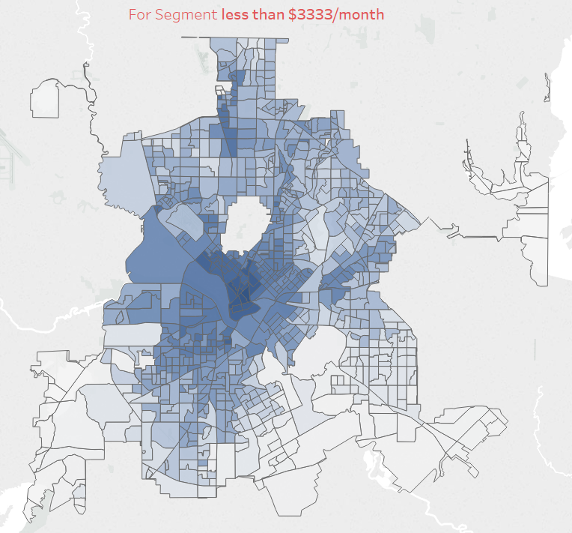
% Accessibility of Jobs within 60 Mins by Transit
Dark Blue
60 – 40 %
Blue
40 - 30 %
30 -10 %
Light Blue
0 – 10%
White

Slide 9
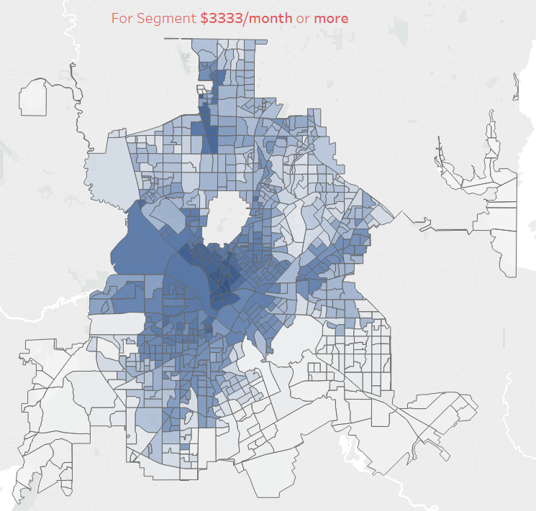
% Accessibility of Jobs within 60 Mins by Transit
Dark Blue
70 – 50 %
Blue
50 - 30 %
30 -10 %
Light Blue
0 – 10%
White

Slide 10
Accessibility of Jobs within 60 Mins Insights
The maximum percentage of jobs that can be accessed with 60mins by transit is 60% for segment wages below $3333/month.
The maximum percentage of jobs that can be accessed with 60mins by transit is 69% for segment wages below $3333/month.
Most of the area have job accessibility between 0% to 10 %.

Slide 11
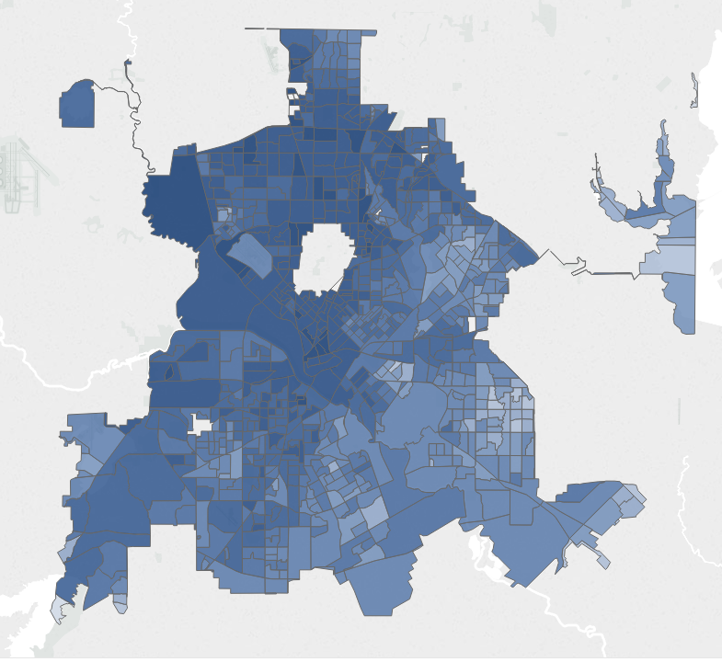
% Accessibility of Jobs within 30 Mins by Car
Dark Blue
0 – 7 Mins
Blue
8 - 15 Mins
15 -22 Mins
Light Blue
23 – 30 Mins
White

Slide 12
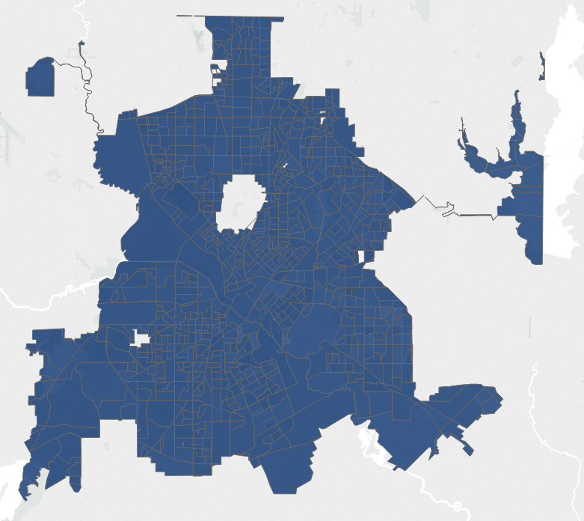
% Accessibility of Jobs within 60 Mins by Car
Dark Blue
0 – 15 Mins
Blue
15 – 30 Mins
30 – 45 Mins
Light Blue
45 – 60 Mins
White

Slide 13
Procedures for Other Resources
American Community Survey Data (ACS) => Census Bureau via API (Python)
Locations for different Resources => Map.io, Google Map
Calculating Travel time => OTP, GTFS
Mapping => QGIS, Tableau
Combining the data => SQL, R, Python

Slide 14
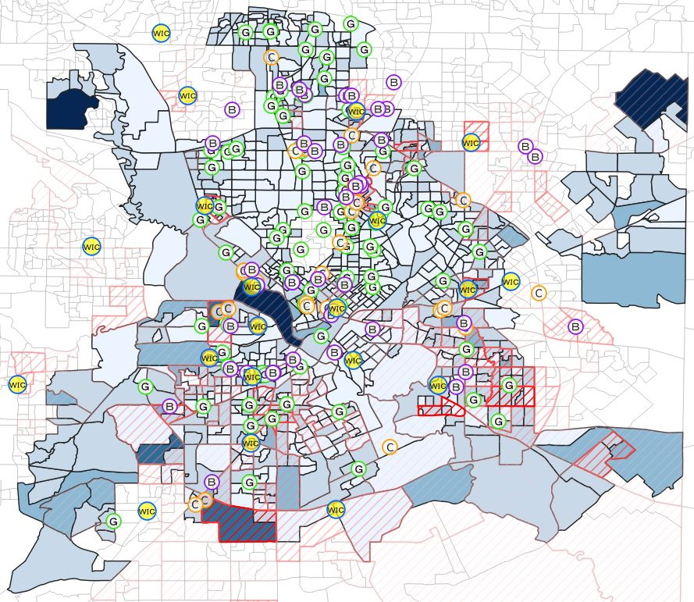
Population
Dark Blue
6000 Above
Blue
4500 – 6000
3000 - 4500
Light Blue
Even Lighter Blue
0 – 1500
White
1500 - 3000
Darker Red means Higher amount of Child in Poverty
Red Slash

Slide 15
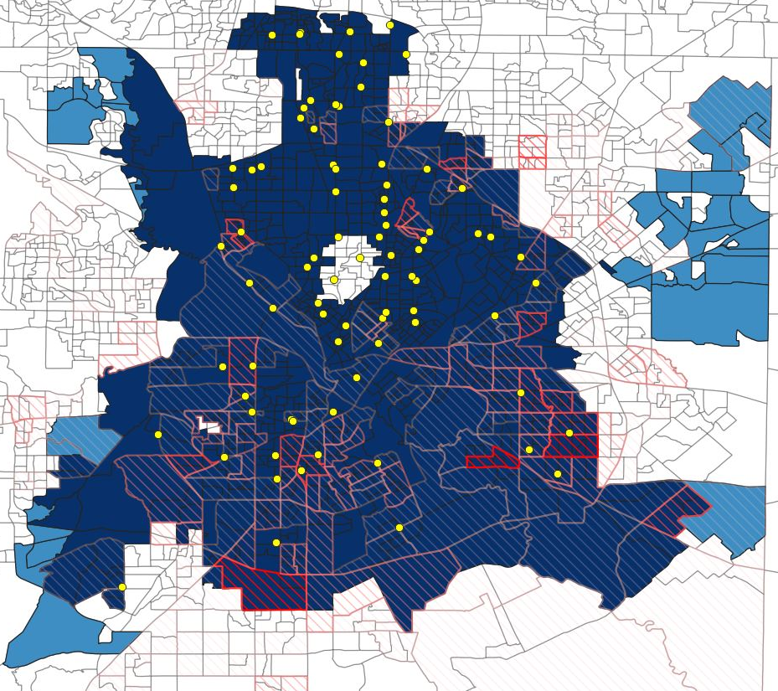
Q4. Groceries By Car
Dark Blue
0 – 15 Mins (96.33%)
Blue
15 – 30 Mins (3.67%)
30 – 45 Mins (0%)
Light Blue
45 – 60 Mins (0%)
White

Slide 16
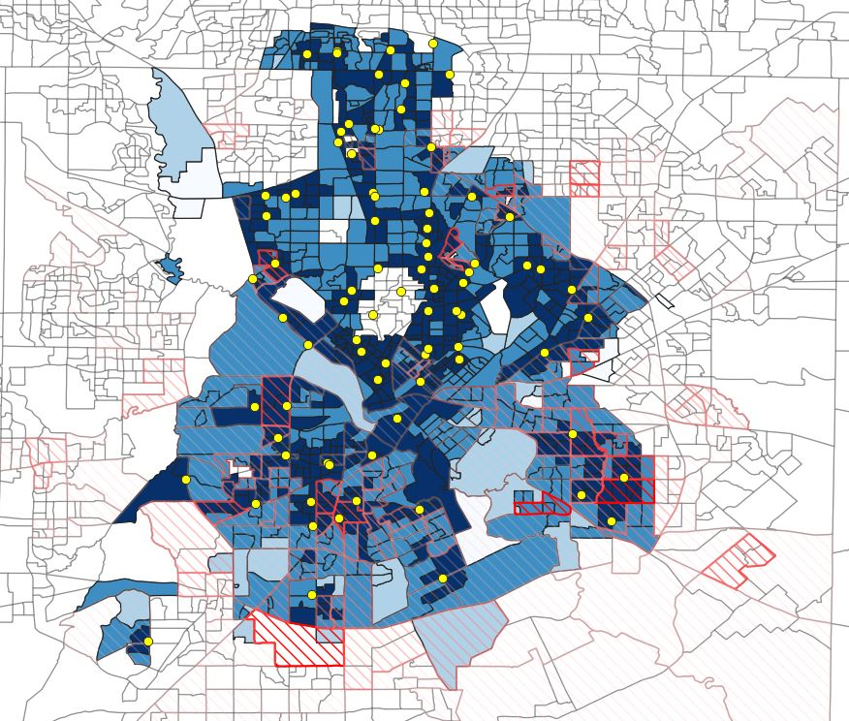
Q4. Groceries By Transit
Dark Blue
0 – 15 Mins (45.46%)
Blue
15 – 30 Mins (41.97%)
30 – 45 Mins (3.79%)
Light Blue
45 – 60 Mins (0.9%)
White

Slide 17
Groceries Insights
Majority of CBG within City of Dallas can reach to the grocery store within 30 mins by Car or by Transit
Most of the area that have higher amount of children in poverty still can easily access to the nearby grocery store within 15 or 30 mins

Slide 18
Groceries Insights

Slide 19
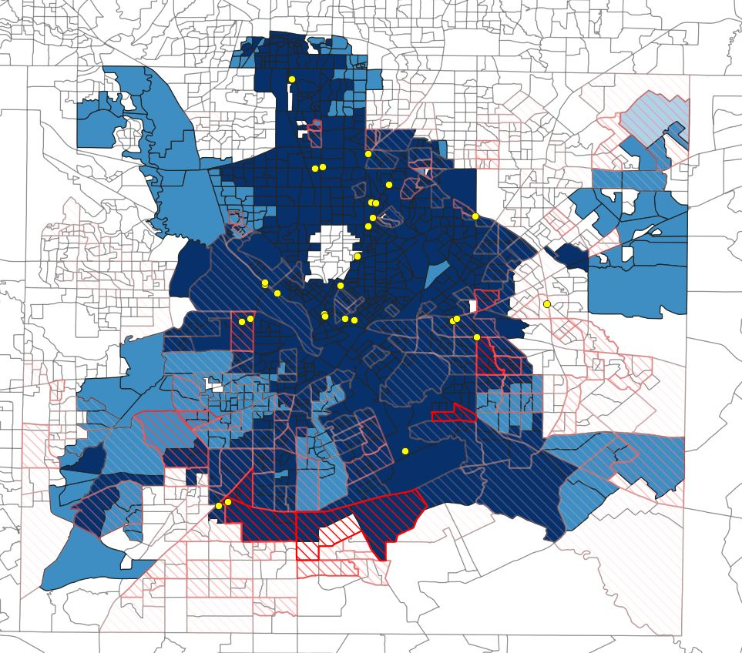
Q5. Women’s Clinic By Car
Dark Blue
0 – 15 Mins (77.18%)
Blue
15 – 30 Mins (22.72%)
30 – 45 Mins (0.1%)
Light Blue
45 – 60 Mins (0%)
White

Slide 20
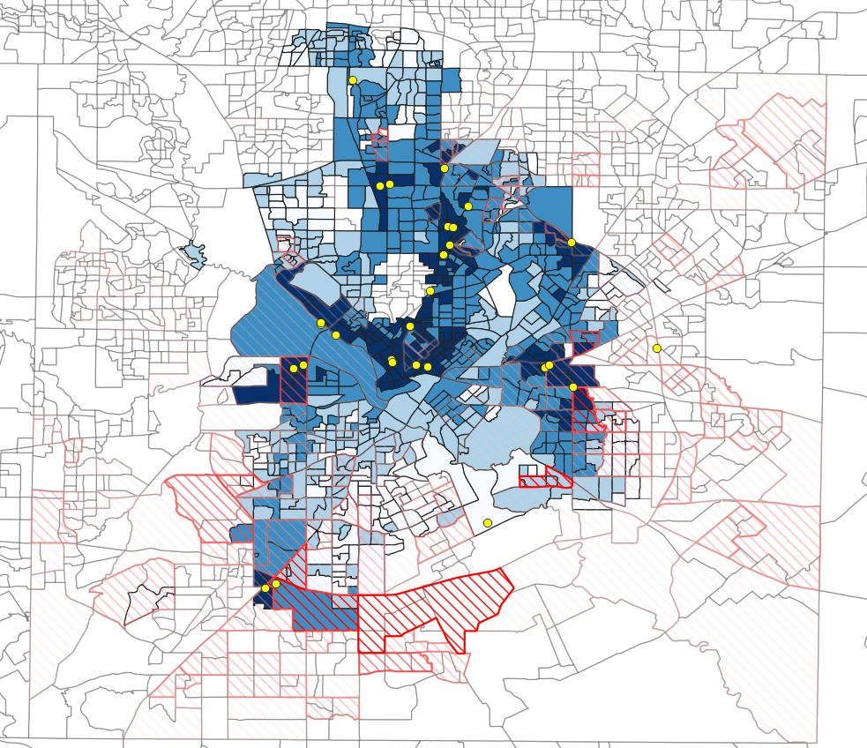
Q5. Women’s Clinic By Transit
Dark Blue
0 – 15 Mins (15.35%)
Blue
15 – 30 Mins (28.41%)
30 – 45 Mins (26.12%)
Light Blue
45 – 60 Mins (14.26%)
White

Slide 21
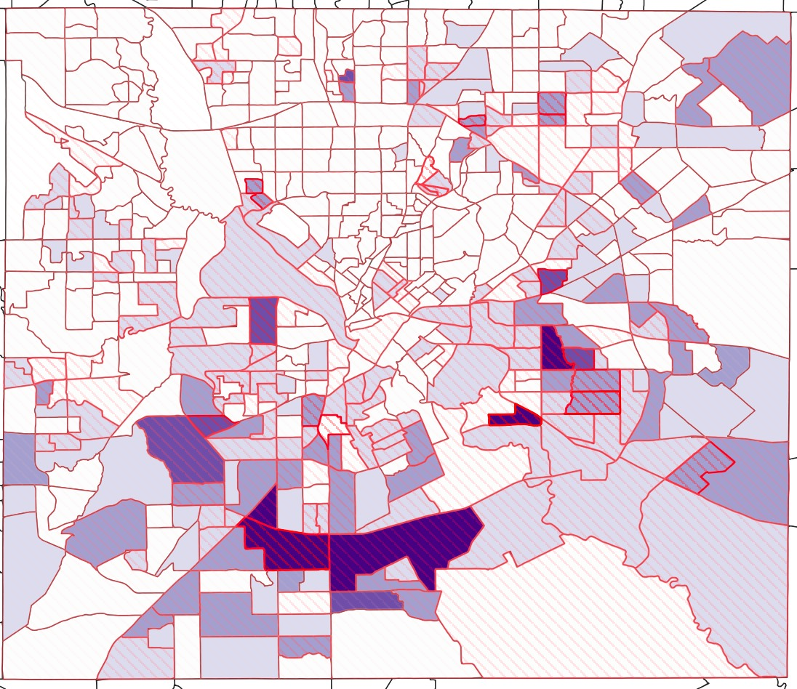
Combination Map
Child in Poverty
Darker red Means Higher Amount Child in Poverty
Single Mom
Darker Purple Means Higher Amount Single Mom

Slide 22
Women’s Clinic Insights
Only 43.76% of CBGs in the City of Dallas have accessibility to women's clinic within 30 mins by Transit. Compare to 100% within 30 mins by Car
Majority of single mother family lives south area in the City of Dallas, but there is not enough Women's Clinic and public transportation in that area
The area with higher amount of Child in poverty is pretty much same as the area having higher amount of single mother family

Slide 23
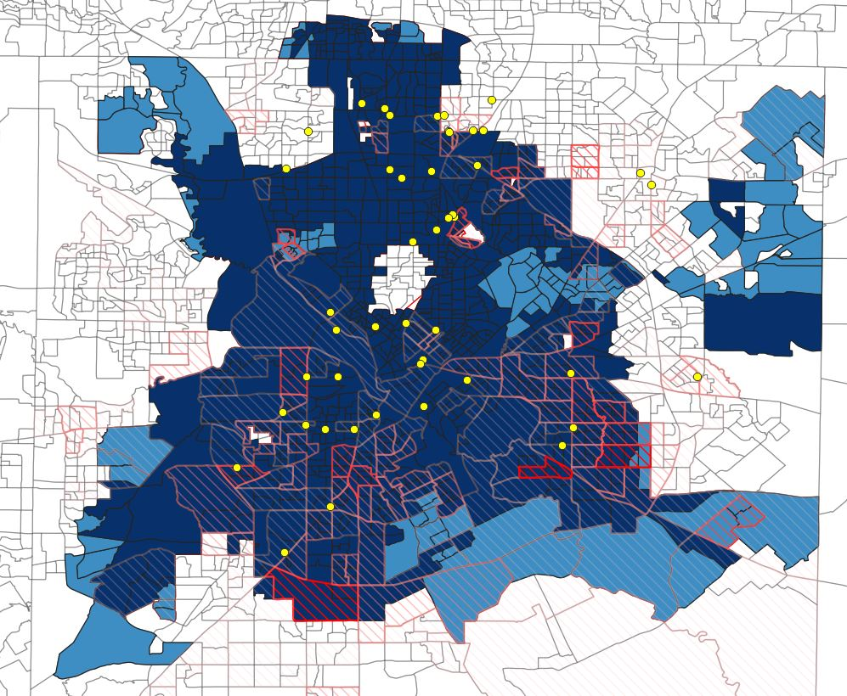
Q6. Basic Medical Clinic By Car
Dark Blue
0 – 15 Mins (87.77%)
Blue
15 – 30 Mins (12.23%)
30 – 45 Mins (0%)
Light Blue
45 – 60 Mins (0%)
White

Slide 24
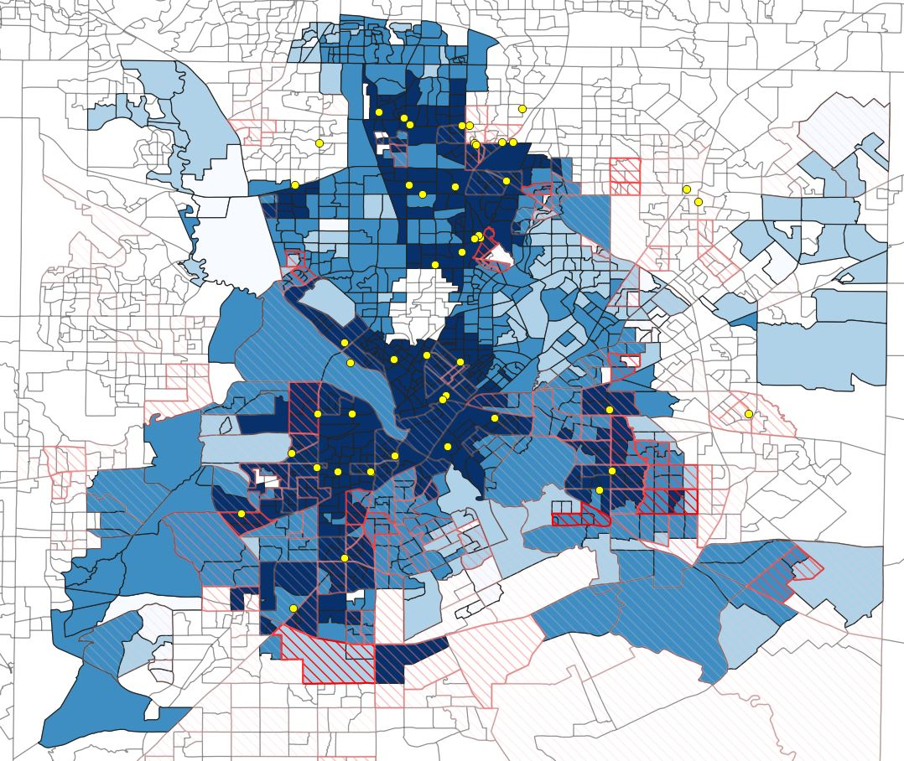
Q6. Basic Medical Clinic By Transit
Dark Blue
0 – 15 Mins (38.19%)
Blue
15 – 30 Mins (39.98%)
30 – 45 Mins (14.46%)
Light Blue
45 – 60 Mins (2.99%)
White

Slide 25
Basic Medical Clinic Insights
All CBG can reach Basic Medical Clinic within 30 minutes by Car While using Transit and Walk around 80% of CBG can reach to the Clinic within 30 mins
The bottom and bottom right area of the map, which have higher amount of Child in poverty with longer travel time requires more public transportation assistance so that they can have quicker access to the clinic

Slide 26
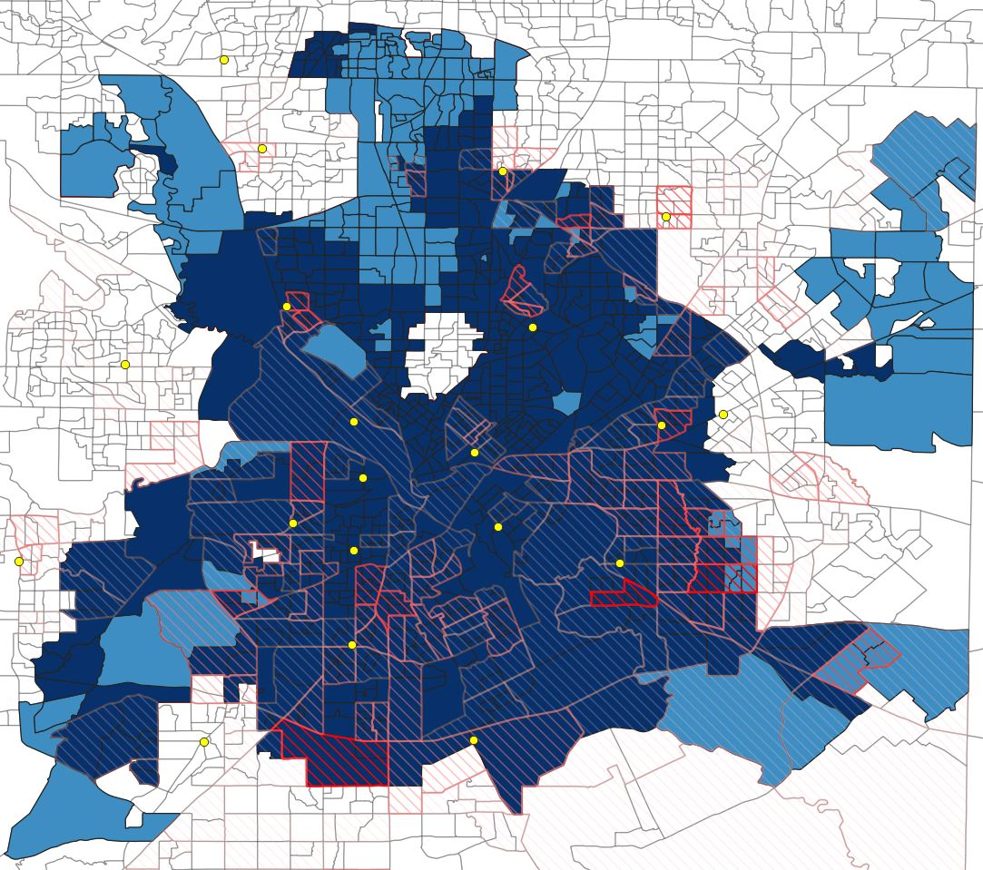
Q7. WIC By Car
Dark Blue
0 – 15 Mins (83.28%)
Blue
15 – 30 Mins (16.72%)
30 – 45 Mins (0%)
Light Blue
45 – 60 Mins (0%)
White

Slide 27
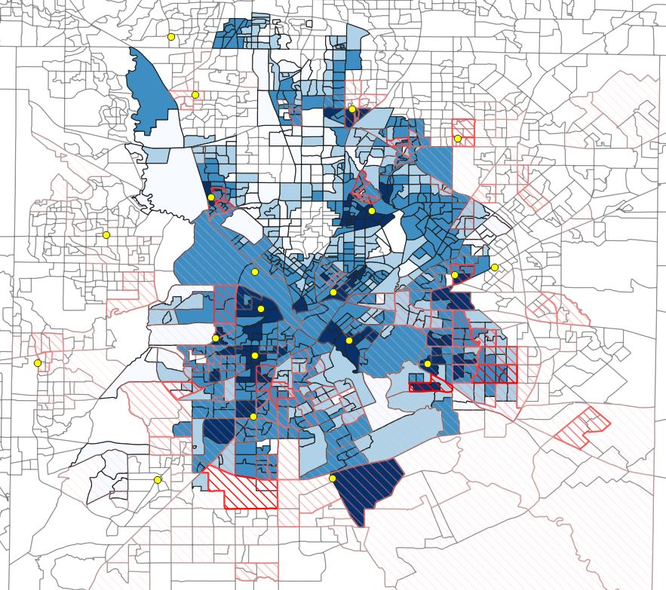
Q7. WIC By Transit
Dark Blue
0 – 15 Mins (9.87%)
Blue
15 – 30 Mins (43.67%)
30 – 45 Mins (24.73%)
Light Blue
45 – 60 Mins (8.87%)
White

Slide 28
Q7. WIC By Transit
Travel Time
Below 30 Mins
30 – 40 Mins
40 – 50 Mins
50 – 60 Mins
Average Waiting Time
0
1.82
4.35
11.84

Slide 29
WIC Insights
All the CBG can reach WIC within 30 minutes by Car Compares to using Transit and Walk Only 53.54% of CBG can reach WIC within 30 mins
CBG with Transit Travel time above 30 mins corelated with the longer waiting time for transit or transfer. Therefore, we can largely decrease the travel time by Increasing or Optimizing the frequency of the bus or DART

